Slide 1
introduction
فريق
المدربين
فريق قيادي يسعى لتطوير عقلية المستهدفين

Slide 2
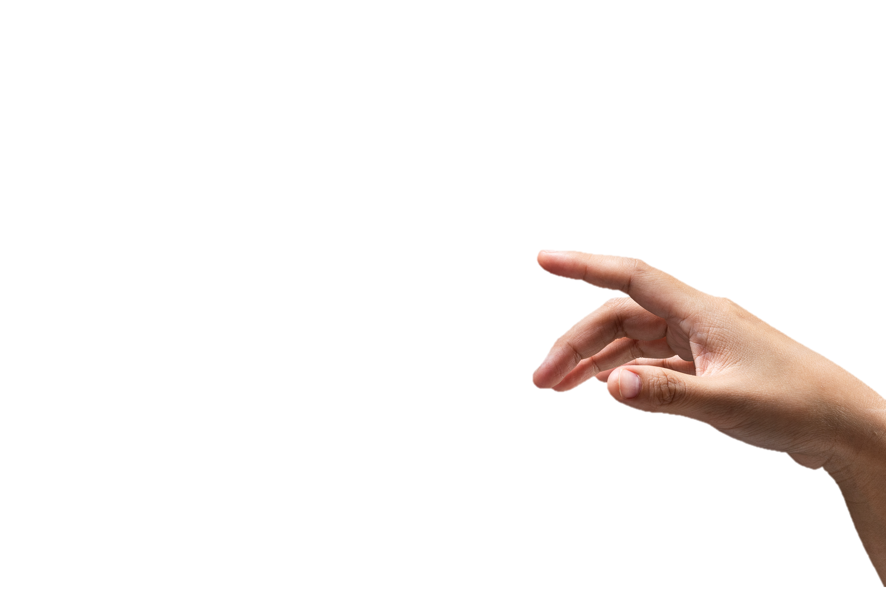
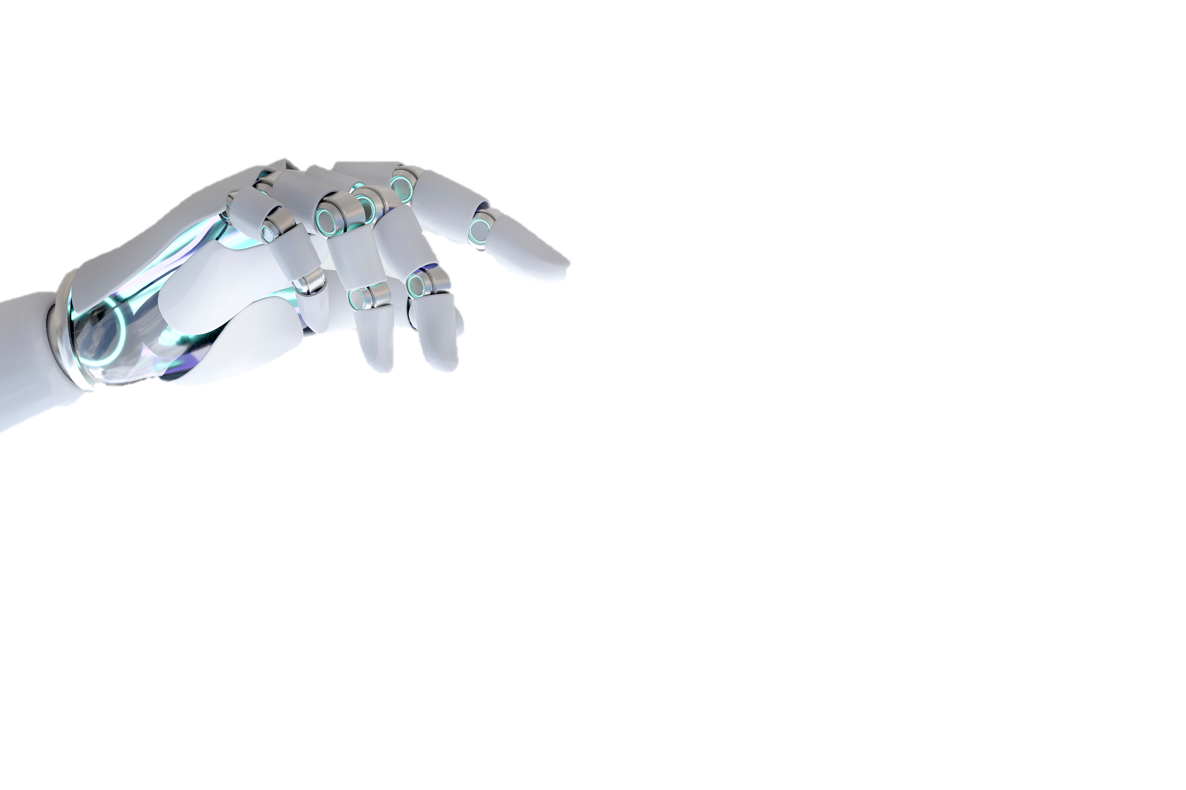
A I
المقدمة
Subtitle
نحن فريق شبابي مليء بالحماس والطموح، نسعى لتقديم دورات تدريبية متميزة تخدم كافة شرائح المجتمع المتنوعة. رؤيتنا هي تمكين الشباب من اكتساب القيم الإيجابية وترسيخ المفاهيم الصحيحة التي تبني مستقبلًا أفضل.
نحن نتميز بالمرونة في التعامل مع جميع الفئات، مما يضمن تلبية احتياجات الجميع وتقديم تجربة تعليمية ثرية ومؤثرة.
Forge
“Using Ai For automatic subtitles generation”

Slide 3











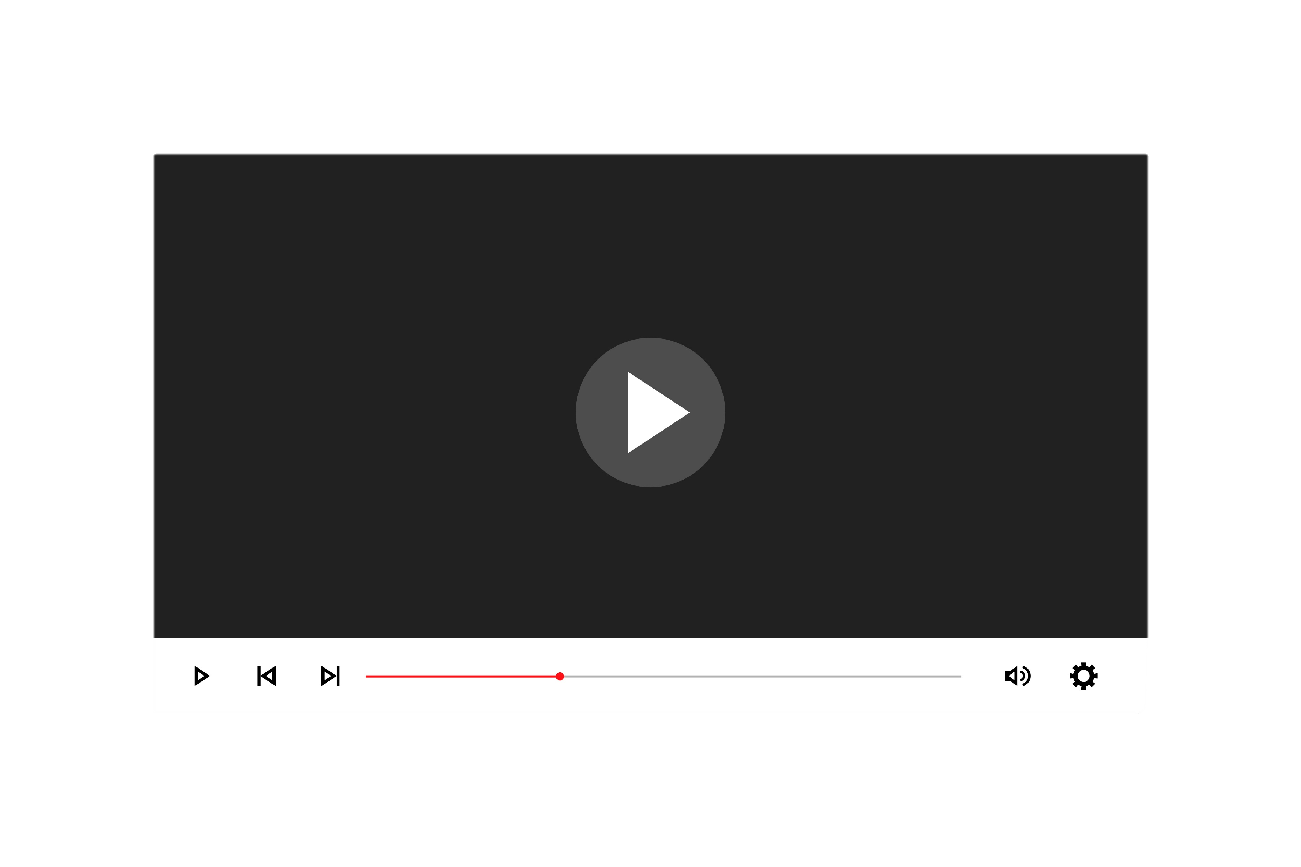
Introduction
Our
Main
Approach
C
A
B
برنامج الفريق
تنمية المهارات الشخصية: نعمل على تطوير مهارات الشباب الشخصية والمهنية ليصبحوا قادة المستقبل.
التنوع والشمول: نسعى لخلق بيئة تعليمية شاملة تحترم التنوع وتقدر الاختلافات.
استخدام التقنيات الحديثة: نعتمد على أحدث وسائل التكنولوجيا لضمان تجربة تعليمية متكاملة ومتقدمة.
التفاعل والمشاركة: نحرص على تشجيع التفاعل والمشاركة الفعالة من جميع المشاركين لتحقيق أقصى استفادة.
متابعة مستمرة: نقدم دعمًا مستمرًا ومتابعة ما بعد الدورات لضمان تطبيق المفاهيم المكتسبة على أرض الواقع.
التعاون مع الجهات المختلفة: نعمل بالتعاون مع مختلف المؤسسات لضمان تقديم محتوى متكامل يلبي احتياجات المجتمع.
Speech-to-Text Conversion
Subtitles Generation
Editing and customization
This step is so crucial to our project, it can be considered the main block of the process, as this is where we will use the Whisper AI model to extract the text out of speech.
At this step, the translation process of the extracted text takes place, the SRT file will be translated to the user choice of language keeping the timestamps intact.
This can be considered the last station in the project, where the user will be able to edit and refine the generated subtitles through our easy-to-use interface

Slide 4
Introduction
A I
C
A
B
أبعاد
introduction
القيادة
Speech-to-Text Conversion
Subtitles Generation
Editing and customization
التدريبية
This step is so crucial to our project, it can be considered the main block of the process, as this is where we will use the Whisper AI model to extract the text out of speech.
At this step, the translation process of the extracted text takes place, the SRT file will be translated to the user choice of language keeping the timestamps intact.
This can be considered the last station in the project, where the user will be able to edit and refine the generated subtitles through our easy-to-use interface

Slide 5
Introduction
A I
A
B
C
الصفات الشخصية
المهارات الفنية والتقنية
القدرات القيادية والاجتماعية
الصفات الشخصية للمدرب القيادي هي الأساس الذي يبنى عليه نجاحه في التأثير والإلهام. هذه الصفات تعكس جوهره وتميزه في التعامل مع المتدربين وتحقيق الأهداف التدريبية.
المدرب القيادي يحتاج إلى مهارات فنية وتقنية قوية لدعم عمليته التدريبية وتحقيق النتائج المرجوة. هذه المهارات تمكنه من استخدام الأدوات والتقنيات الحديثة بكفاءة وفعالية.
قدرات المدرب القيادية والاجتماعية هي ما تجعله قادراً على توجيه وإلهام الآخرين، وتعزيز التعاون والعمل الجماعي. هذه القدرات تعزز من تأثيره الاجتماعي وتجعله قائداً حقيقياً.

Slide 6
Introduction
A I
A
B
C
الصفات الشخصية
Subtitles Generation
Editing and customization
تتجلى الصفات الشخصية للمدرب القيادي كأحد الركائز الأساسية التي تساهم في نجاحه وتأثيره الفعال على لمتدربين. هذه الصفات لا تقتصر فقط على الجوانب الأخلاقية، بل تمتد لتشمل القدرة على التأثير الإيجابي وإلهام الآخرين من خلال التواصل والتفاعل. فالقوة الداخلية والاتزان الشخصي هما ما يميزان المدرب القيادي عن غيره، حيث يستطيع أن يكون قدوة حقيقية يحتذى بها.
This step is so crucial to our project, it can be considered the main block of the process, as this is where we will use the Whisper AI model to extract the text out of speech.
At this step, the translation process of the extracted text takes place, the SRT file will be translated to the user choice of language keeping the timestamps intact.
This can be considered the last station in the project, where the user will be able to edit and refine the generated subtitles through our easy-to-use interface

Slide 7
Introduction
A
B
C
الصفات الشخصية التي يجب أن يتمتع بها المدرب القيادي
Subtitles Generation
Editing and customization
Speech-to-Text Conversion
الأخلاق العالية: يتميز بالصدق، الأمانة، والنزاهة في كل تعاملاته.
القدرة على التأثير: يمتلك صوتاً قوياً وواضحاً يمكنه من التأثير الإيجابي على المتدربين.
الحركات والتعبير الجسدي: يستخدم لغة الجسد بفعالية لتعزيز الرسائل التي يقدمها.
التفكير والتحليل الإبداعي: قادر على التفكير خارج الصندوق وحل المشكلات بطرق مبتكرة.
This step is so crucial to our project, it can be considered the main block of the process, as this is where we will use the Whisper AI model to extract the text out of speech.
At this step, the translation process of the extracted text takes place, the SRT file will be translated to the user choice of language keeping the timestamps intact.
This can be considered the last station in the project, where the user will be able to edit and refine the generated subtitles through our easy-to-use interface

Slide 8
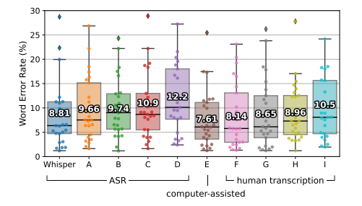
Introduction
A I
A
B
C
المهارات الفنية والتقنية
Editing and customization
Speech-to-Text Conversion
في عالمنا المتسارع والمتغير، تصبح المهارات الفنية والتقنية أمراً لا غنى عنه لأي مدرب قيادي يسعى لتحقيق التميز. إن امتلاك المعرفة التقنية والقدرة على استخدام الأدوات الحديثة يساهم بشكل كبير في تحسين العملية التدريبية وجعلها أكثر فعالية وإنتاجية. هذه المهارات تشمل القدرة على التواصل بفعالية، استخدام البرمجيات المتقدمة، وتنظيم الوقت بشكل مثالي، مما يضمن تحقيق الأهداف التدريبية بكفاءة عالية
This step is so crucial to our project, it can be considered the main block of the process, as this is where we will use the Whisper AI model to extract the text out of speech.
At this step, the translation process of the extracted text takes place, the SRT file will be translated to the user choice of language keeping the timestamps intact.
This can be considered the last station in the project, where the user will be able to edit and refine the generated subtitles through our easy-to-use interface
Whisper model performed very well in comparison to human transcriptions and other ASR systems.
WER distributions of 25 recordings
Adapted from: Radford et al., Robust Speech Recognition via Large-Scale Weak Supervision.

Slide 9
Introduction
B
A I
A
Subtitles Generation
C
أبرز المهارات الفنية والتقنية التي يجب أن يتحلى بها المدرب القيادي
Editing and customization
Speech-to-Text Conversion
مهارات الاتصال والتواصل: يجيد التواصل بشكل فعال وواضح مع جميع الأفراد.
التعامل مع البرامج الحديثة: متمكن من استخدام برامج مايكروسوفت (Word، Excel، (PowerPoint وأدوات أخرى لدعم العملية التدريبية.
إدارة الوقت: قادر على تنظيم وقته بكفاءة لضمان تحقيق الأهداف التدريبية.
إعداد المواد التدريبية: يمتلك القدرة على تصميم وتطوير مواد تدريبية متميزة ومناسبة للفئة المستهدفة.
This step is so crucial to our project, it can be considered the main block of the process, as this is where we will use the Whisper AI model to extract the text out of speech.
At this step, the translation process of the extracted text takes place, the SRT file will be translated to the user choice of language keeping the timestamps intact.
This can be considered the last station in the project, where the user will be able to edit and refine the generated subtitles through our easy-to-use interface
Whisper model performed very well in comparison to human transcriptions and other ASR systems.
WER distributions of 25 recordings
Adapted from: Radford et al., Robust Speech Recognition via Large-Scale Weak Supervision.

Slide 10
Introduction
B
A I
A
Subtitles Generation
C
القدرات القيادية والاجتماعية
Speech-to-Text Conversion
لا تقتصر مهام المدرب القيادي على تقديم المحتوى التدريبي فقط، بل تتعدى ذلك لتشمل توجيه وتحفيز المتدربين، وبناء بيئة تعليمية تفاعلية تعزز من روح الفريق والعمل الجماعي. القدرات القيادية والاجتماعية هي ما يجعله قادرًا على خلق تأثير إيجابي دائم، من خلال قدرته على الخطابة والإلقاء المؤثر، وتحفيز الآخرين، وتعزيز ثقافة الانضباط والإبداع. هذه القدرات تمكنه من تحويل الأفكار إلى أفعال، وتعزيز ثقة المتدربين بأنفسهم، مما يساعدهم على تحقيق النجاح
This step is so crucial to our project, it can be considered the main block of the process, as this is where we will use the Whisper AI model to extract the text out of speech.
At this step, the translation process of the extracted text takes place, the SRT file will be translated to the user choice of language keeping the timestamps intact.
This can be considered the last station in the project, where the user will be able to edit and refine the generated subtitles through our easy-to-use interface
“Srt file processing”
Whisper model performed very well in comparison to human transcriptions and other ASR systems.
The plain text will be sent to the Google Cloud Translation API to get translated to the language that the user have chosen.
Keeping the timestamps intact.
Google Cloud Translation API is among the best in this field providing a great relative accuracy.
WER distributions of 25 recordings
Adapted from: Radford et al., Robust Speech Recognition via Large-Scale Weak Supervision.

Slide 11
Introduction
B
A I
C
A
Subtitles Generation
أهم القدرات القيادية والاجتماعية للمدرب القيادي
العمل الجماعي: يعزز من روح الفريق ويشجع التعاون بين المتدربين.
القيادة والتأثير الاجتماعي: قادر على قيادة المجموعات وإلهام الآخرين لتحقيق النجاح.
الخطابة والإلقاء: يجيد فنون الخطابة والإلقاء، مما يمكنه من إيصال الأفكار بوضوح وجذب انتباه المتدربين.
الانضباط والالتزام: يلتزم بالمواعيد والتعليمات، ويشجع الآخرين على الالتزام.
مهارات العصف الذهني: يستخدم تقنيات العصف الذهني لتعزيز التفكير الجماعي وتوليد الأفكار الجديدة.
فن المناظرات: يدرب المتدربين على فن المناظرات لتقوية وجهات نظرهم وزيادة ثقتهم بأنفسهم.
Speech-to-Text Conversion
This step is so crucial to our project, it can be considered the main block of the process, as this is where we will use the Whisper AI model to extract the text out of speech.
At this step, the translation process of the extracted text takes place, the SRT file will be translated to the user choice of language keeping the timestamps intact.
This can be considered the last station in the project, where the user will be able to edit and refine the generated subtitles through our easy-to-use interface
“Srt file processing”
Whisper model performed very well in comparison to human transcriptions and other ASR systems.
The plain text will be sent to the Google Cloud Translation API to get translated to the language that the user have chosen.
Keeping the timestamps intact.
Google Cloud Translation API is among the best in this field providing a great relative accuracy.
WER distributions of 25 recordings
Adapted from: Radford et al., Robust Speech Recognition via Large-Scale Weak Supervision.

Slide 12
Introduction
B
A I
C
A
Subtitles Generation
coffee
Speech-to-Text Conversion
breaks
This step is so crucial to our project, it can be considered the main block of the process, as this is where we will use the Whisper AI model to extract the text out of speech.
At this step, the translation process of the extracted text takes place, the SRT file will be translated to the user choice of language keeping the timestamps intact.
This can be considered the last station in the project, where the user will be able to edit and refine the generated subtitles through our easy-to-use interface
15 minutes
Editing and customization
“Srt file processing”
Whisper model performed very well in comparison to human transcriptions and other ASR systems.
The user is presented with an interface to review the generated subtitles and edit them accordingly in case there were any type of errors.
And will be also able to customize the way the subtitles are presented in terms of color and font size.
This will give more flexibility for the users and will also give the users with visual difficulties such as color blindness more control over the subtitles.
The plain text will be sent to the Google Cloud Translation API to get translated to the language that the user have chosen.
Keeping the timestamps intact.
Google Cloud Translation API is among the best in this field providing a great relative accuracy.
WER distributions of 25 recordings
Adapted from: Radford et al., Robust Speech Recognition via Large-Scale Weak Supervision.

Slide 13
Introduction
Results
B
A I
C
Testing
A
نشاط تدريبي
مساء الخير، مستمعينا الأعزاء. في تقريرنا اليوم، نسلط الضوء على المدرب القيادي ودوره الهام في المجتمع.
المدرب القيادي يتميز بصفات شخصية متميزة مثل الصدق والأمانة، وقدرته على التأثير بصوت قوي ولغة جسد فعالة. كما يمتلك مهارات فنية وتقنية تشمل التواصل الفعال واستخدام البرامج الحديثة مثل مايكروسوفت أوفيس وإدارة الوقت بكفاءة.
إلى جانب ذلك، يتمتع المدرب القيادي بقدرات قيادية واجتماعية، تعزز العمل الجماعي، ومهارات الخطابة، والانضباط، مما يساهم في بناء الثقة بالنفس لدى المتدربين.
كان معكم [المدرب] من فريق المدربين. نشكركم على حسن الاستماع، ونتمنى لكم مساءً سعيدًا.
Speech-to-Text Conversion
This step is so crucial to our project, it can be considered the main block of the process, as this is where we will use the Whisper AI model to extract the text out of speech.
At this step, the translation process of the extracted text takes place, the SRT file will be translated to the user choice of language keeping the timestamps intact.
This can be considered the last station in the project, where the user will be able to edit and refine the generated subtitles through our easy-to-use interface
Editing and customization
“Srt file processing”
Whisper model performed very well in comparison to human transcriptions and other ASR systems.
The user is presented with an interface to review the generated subtitles and edit them accordingly in case there were any type of errors.
And will be also able to customize the way the subtitles are presented in terms of color and font size.
This will give more flexibility for the users and will also give the users with visual difficulties such as color blindness more control over the subtitles.
The plain text will be sent to the Google Cloud Translation API to get translated to the language that the user have chosen.
Keeping the timestamps intact.
Google Cloud Translation API is among the best in this field providing a great relative accuracy.
WER distributions of 25 recordings
Adapted from: Radford et al., Robust Speech Recognition via Large-Scale Weak Supervision.

Slide 14
Introduction
B
A I
C
A
“Testing step”
أنواع
In terms of accuracy, we found the overall accuracy including the two processes of text generation and translation to be an average of 94.87% across different types of content.
Speech-to-Text Conversion
التدريبات
This step is so crucial to our project, it can be considered the main block of the process, as this is where we will use the Whisper AI model to extract the text out of speech.
At this step, the translation process of the extracted text takes place, the SRT file will be translated to the user choice of language keeping the timestamps intact.
This can be considered the last station in the project, where the user will be able to edit and refine the generated subtitles through our easy-to-use interface
The results that we have obtained can be looked at from two different perspectives: time and accuracy.
In terms of time, we have concluded that the process takes about 65% of the original video length.
Editing and customization
“Srt file processing”
Whisper model performed very well in comparison to human transcriptions and other ASR systems.
65%
The user is presented with an interface to review the generated subtitles and edit them accordingly in case there were any type of errors.
And will be also able to customize the way the subtitles are presented in terms of color and font size.
This will give more flexibility for the users and will also give the users with visual difficulties such as color blindness more control over the subtitles.
The plain text will be sent to the Google Cloud Translation API to get translated to the language that the user have chosen.
Keeping the timestamps intact.
Google Cloud Translation API is among the best in this field providing a great relative accuracy.
WER distributions of 25 recordings
Adapted from: Radford et al., Robust Speech Recognition via Large-Scale Weak Supervision.

Slide 15
Introduction
A I
C
3 أنواع للجلسة
Editing and customization
الجلسة النظرية
الجلسة الحركية
الجلسة المدمجة
This step is so crucial to our project, it can be considered the main block of the process, as this is where we will use the Whisper AI model to extract the text out of speech.
At this step, the translation process of the extracted text takes place, the SRT file will be translated to the user choice of language keeping the timestamps intact.
This can be considered the last station in the project, where the user will be able to edit and refine the generated subtitles through our easy-to-use interface
WER distributions of 25 recordings
Adapted from: Radford et al., Robust Speech Recognition via Large-Scale Weak Supervision.

Slide 16
Introduction
B
A I
C
A
“Testing step”
الخطة
In terms of accuracy, we found the overall accuracy including the two processes of text generation and translation to be an average of 94.87% across different types of content.
Speech-to-Text Conversion
المستقبلية
This step is so crucial to our project, it can be considered the main block of the process, as this is where we will use the Whisper AI model to extract the text out of speech.
At this step, the translation process of the extracted text takes place, the SRT file will be translated to the user choice of language keeping the timestamps intact.
This can be considered the last station in the project, where the user will be able to edit and refine the generated subtitles through our easy-to-use interface
لنهاية سنة 2024
WER distributions of 25 recordings
Adapted from: Radford et al., Robust Speech Recognition via Large-Scale Weak Supervision.

Slide 17
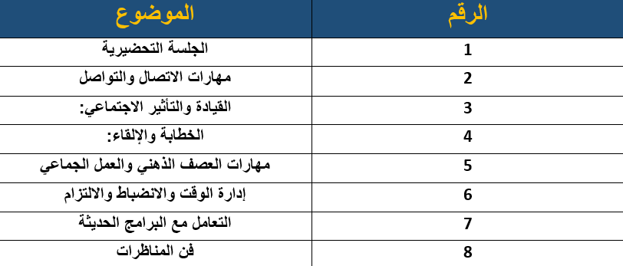
Introduction
Results
B
A I
C
Testing
A
الخطة المستقبلية
لتفعيل فريق قيادي قادر على تحقيق أهداف فريق المدربين
Speech-to-Text Conversion
This step is so crucial to our project, it can be considered the main block of the process, as this is where we will use the Whisper AI model to extract the text out of speech.
At this step, the translation process of the extracted text takes place, the SRT file will be translated to the user choice of language keeping the timestamps intact.
This can be considered the last station in the project, where the user will be able to edit and refine the generated subtitles through our easy-to-use interface
WER distributions of 25 recordings
Adapted from: Radford et al., Robust Speech Recognition via Large-Scale Weak Supervision.

Slide 18
Introduction
Thank
A
B
A I
Future
C
You!
Work
النقاط التي يجب توفيرها في كل جلسة
“Testing step”
قاعة تدريبية متكاملة
إيجاد ضيافة إن أمكن
توفير استراحات للتدريب
تحديد ميثاق الجلسة
In terms of accuracy, we found the overall accuracy including the two processes of text generation and translation to be an average of 94.87% across different types of content.
Speech-to-Text Conversion
This step is so crucial to our project, it can be considered the main block of the process, as this is where we will use the Whisper AI model to extract the text out of speech.
At this step, the translation process of the extracted text takes place, the SRT file will be translated to the user choice of language keeping the timestamps intact.
This can be considered the last station in the project, where the user will be able to edit and refine the generated subtitles through our easy-to-use interface
The results that we have obtained can be looked at from two different perspectives: time and accuracy.
In terms of time, we have concluded that the process takes about 65% of the original video length.
Editing and customization
“Srt file processing”
Whisper model performed very well in comparison to human transcriptions and other ASR systems.
65%
The user is presented with an interface to review the generated subtitles and edit them accordingly in case there were any type of errors.
And will be also able to customize the way the subtitles are presented in terms of color and font size.
This will give more flexibility for the users and will also give the users with visual difficulties such as color blindness more control over the subtitles.
The plain text will be sent to the Google Cloud Translation API to get translated to the language that the user have chosen.
Keeping the timestamps intact.
Google Cloud Translation API is among the best in this field providing a great relative accuracy.
WER distributions of 25 recordings
Adapted from: Radford et al., Robust Speech Recognition via Large-Scale Weak Supervision.

Slide 19
Introduction
A
B
A I
C
Thank
“Testing step”
You!
In terms of accuracy, we found the overall accuracy including the two processes of text generation and translation to be an average of 94.87% across different types of content.
We are planning to incorporate a summarization service alongside the translation, this will put the user a step ahead letting him know what to expect.
It will also allow us to categorize the videos based on their actual content.
We also have plans to transform the site into a platform for subtitled videos and use the data that we get to improve its performance.
Speech-to-Text Conversion
This step is so crucial to our project, it can be considered the main block of the process, as this is where we will use the Whisper AI model to extract the text out of speech.
At this step, the translation process of the extracted text takes place, the SRT file will be translated to the user choice of language keeping the timestamps intact.
This can be considered the last station in the project, where the user will be able to edit and refine the generated subtitles through our easy-to-use interface
Any questions ?
The results that we have obtained can be looked at from two different perspectives: time and accuracy.
In terms of time, we have concluded that the process takes about 65% of the original video length.
Editing and customization
“Srt file processing”
Whisper model performed very well in comparison to human transcriptions and other ASR systems.
65%
The user is presented with an interface to review the generated subtitles and edit them accordingly in case there were any type of errors.
And will be also able to customize the way the subtitles are presented in terms of color and font size.
This will give more flexibility for the users and will also give the users with visual difficulties such as color blindness more control over the subtitles.
The plain text will be sent to the Google Cloud Translation API to get translated to the language that the user have chosen.
Keeping the timestamps intact.
Google Cloud Translation API is among the best in this field providing a great relative accuracy.
WER distributions of 25 recordings
Adapted from: Radford et al., Robust Speech Recognition via Large-Scale Weak Supervision.

